Slide 1
BORN TO CODE
TEAM MEMBER :
1. SUMIT KUMAR
2. SAHIL SINGH

Slide 2
1. SMART TAP
COMPONENTS USED :
1. INFRARED SENSOR
2. 1 K RESISTANCE
3. ZERO PCB
4. DC WATER PUMP

Slide 3
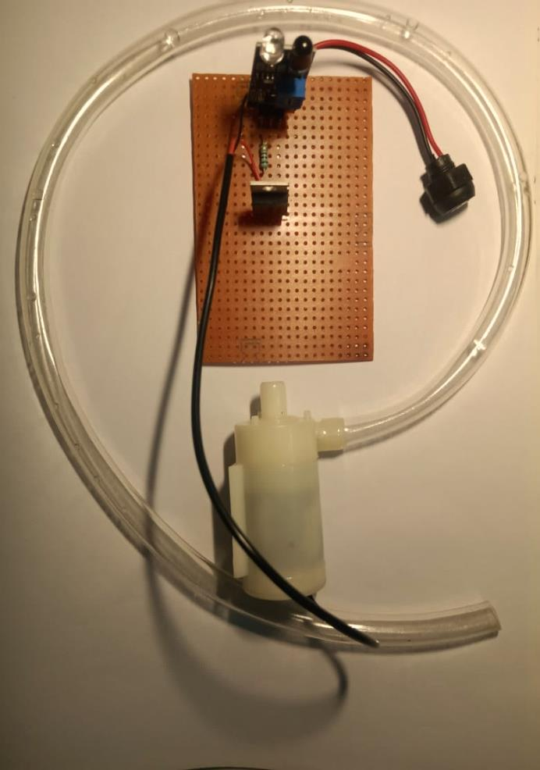
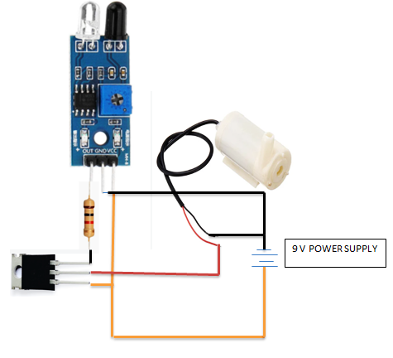
CIRCUIT DIAGRAM
PROJECT AFTER ASSEMBLING

Slide 4
# .Working of this project :-
In this project the water pump is connected to the infrared sensor via TP32C transistor and 1 k resistor . When the power supply is turned on the emitter of infrared sensor starts emitting signal when any obstacle hand or glass comes in front of infrared sensor the emitted signal get reflected and the receiver catch the signal and starts the water pump and the water starts coming and when there is no any obstacle in front of infrared sensor then the signal get disconnected and the water pump switch off.

